Slide 1

C++ Difficulties
Created By:
Jackson Burns
Jose Juan Velasquez

Slide 2
Program
Our program creates a Blackjack game to run in the console. It uses a class Player to store the money and hand of both the dealer, and methods to deal cards, print cards, and money methods. It utilizes two structs to store the deck of cards, organized as a linked list. It utilizes the manual memory management of C++ for creating these structs, and the newly introduced object oriented functionality in C++ from C.

Slide 3
Development Process
Firstly we made the data structures, and some base functionality methods. Using the base structure, we created the main program loop, and fixed the memory leaks. We did several hours of testing and bug squashing, and kept ending up with different display issues, memory leaks, or invalid win checking. Once these were all fixed, money handling methods were developed, and the program was polished, and cards were printed in a human readable way.

Slide 4
Challenges
The number one challenge we had was running into memory leak issues. These were especially hard to debug, because after a few runs our system ran out of memory and had to be restarted.
Another challenge was figuring out how to shuffle the deck of cards since simulating that in code can get complex very quickly

Slide 5
C++ vs other languages
C++ builds off the base syntactic structure of C, with the primary new addition being the capability for Object Oriented Programming. C++ retains the speedy runtime and efficiency of C. Unlike modern OOP languages, C++ has the capability for manual memory management, which opens the possibility of memory leaks. If done correctly, C++ can be an extremely powerful language which can do advanced calculation and algorithms efficiently.

Slide 6
Opinion on C++
As a C-enjoyer I liked working with C++ since it allowed more control on the program
Also, working with classes makes things so much neater to code and C++ provides the control and efficiency of C as well as the OOP feature from Java

Slide 7
Code highlights

Slide 8
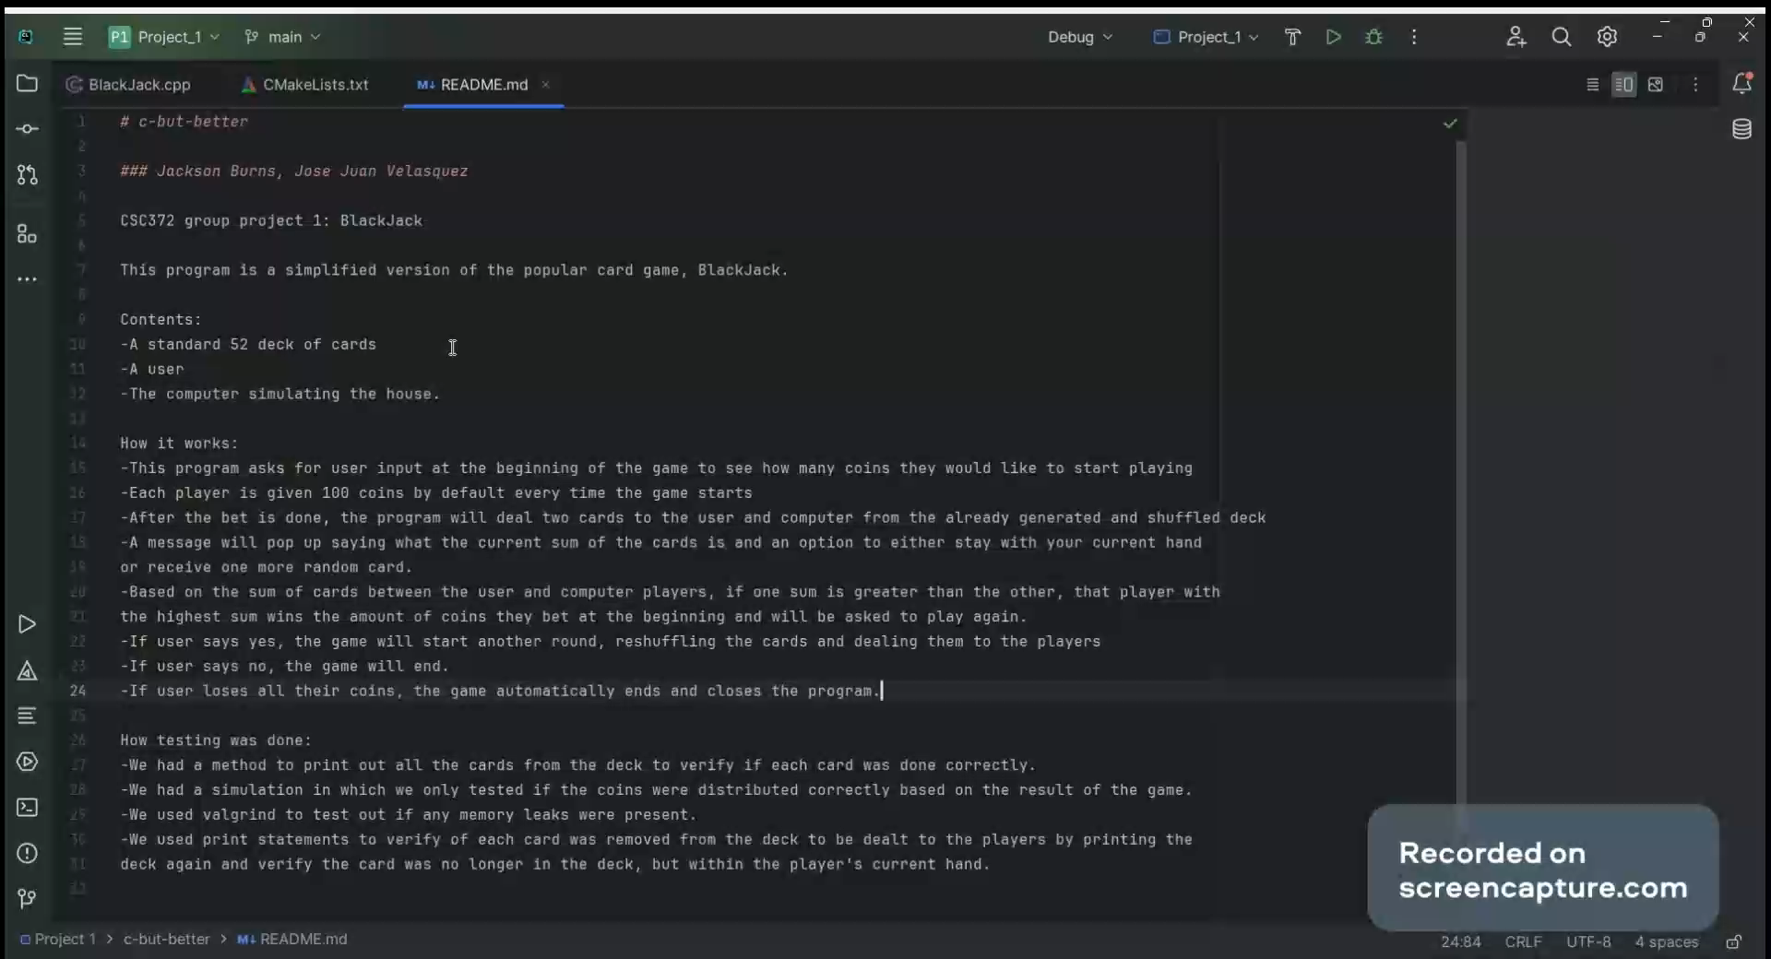

Slide 9
Workload Split
JJ
Structure creation
Node/card creation
Printing the deck and cards
The Player class.
Dealing the cards
The summation of values from the cards
Code sample video
Jackson
Main function that handles the game – main program loop
Money distribution and handling
Memory handling debugging
Deck structure cards synchronizing with both user objects.
Freeing user and deck of cards after each round and game
PowerPoint

